Slide 1
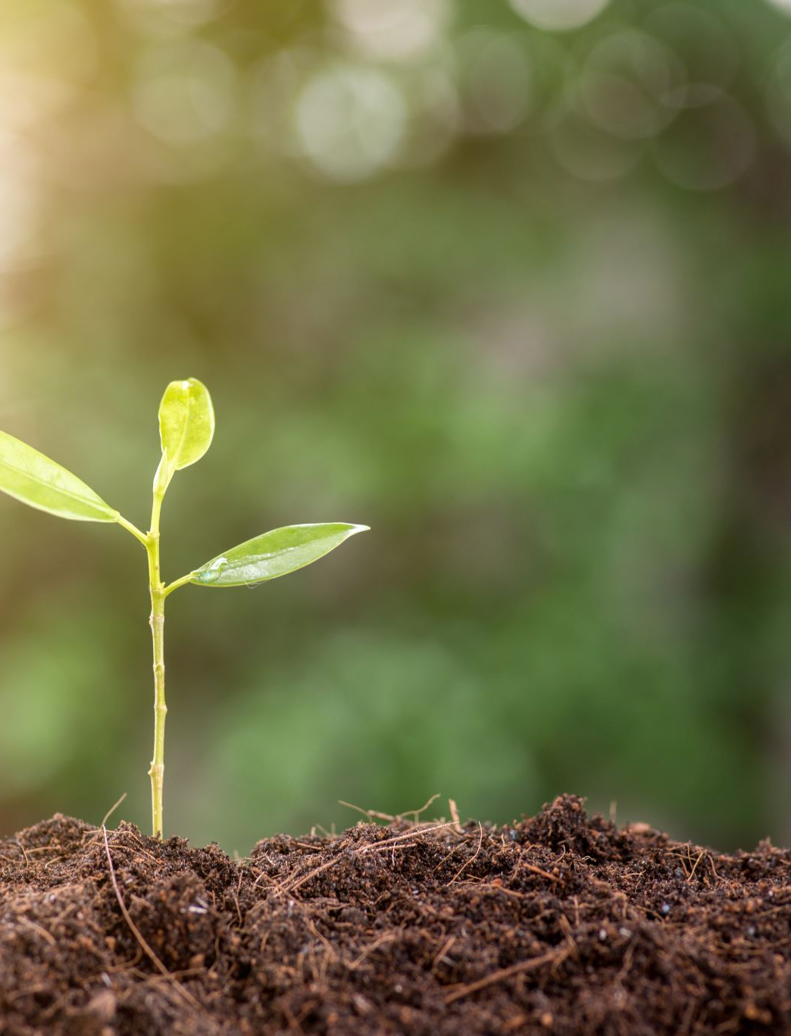
SOIL
Testing soil for nutrients

Slide 2
Problem
Farmers have to wait weeks for soil lab results, which puts valuable crops at risk.
Right now there is no reasonable solution to quickly and continuously analyze and inform farmers about:
Potassium
Nitrogen
Phosphorus
Moisture
Salinity
Temperature
Sunlight

Slide 3
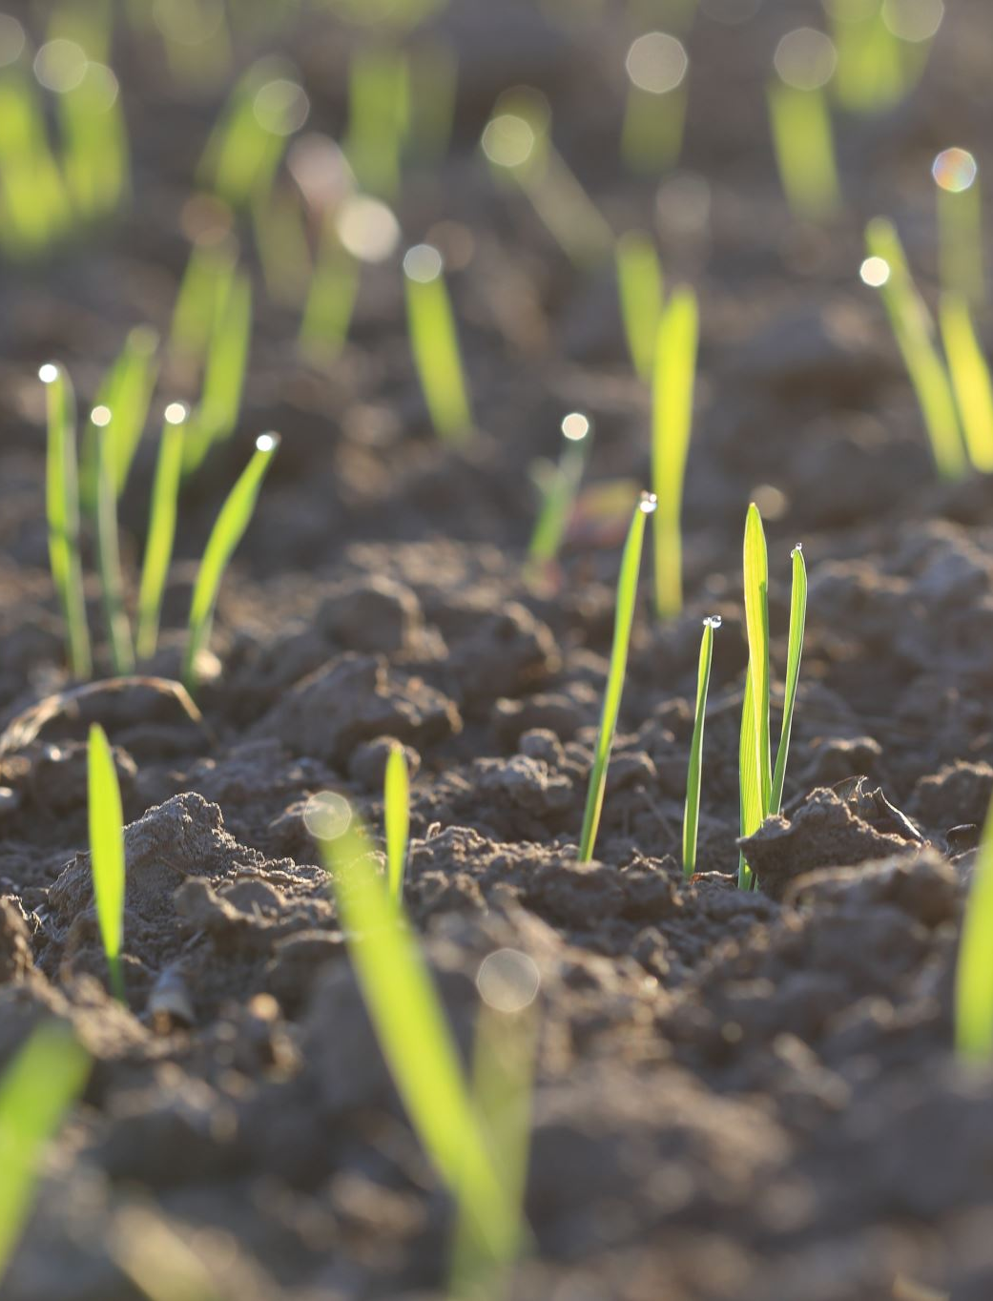
Solution
We created a simple IOT soil testing probe that can be placed long-term in any field, and regularly update farmers on the soil conditions.
Using existing technologies, we can provide a long–awaited solution to giving farmers the ability to know what their soil health and quality at the click of a button. This will allow them to put in less inputs so in total, they will have a better profit off their crop.

Slide 4
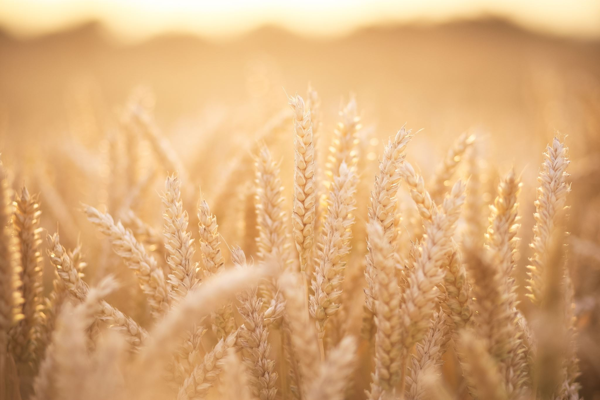
Demo

